Slide 1
Presentation on Cross checking of Works inter Circles, Improvement in Quality of works and O & M services
By : Er Avtar Singh Kalsi,
Chief Engineer(S), PWSSB,
Bathinda 29.08.2018

Slide 2
Agenda of presentation
1. Cross Checking of completed Urban Mission works under Patiala circle
2. Checking of ongoing works of Bathinda Circle
3.Steps Taken to Improve in Quality of works
4. Steps Taken to Improve in O&M delivery Services
5. Review of Cluster works Microplanning
6. Challenges/ Issues

Slide 3
Cross Checking of completed Urban Mission works under Patiala circle
Banur Tubewell Works Visited on 17.08.2018.
Zirakpur water supply &Sewerage Work Visited on 17.08.2018
Mandi Gobindgarh 25MLD STP Visited on 18.08.2018
Mandi Gobindgarh MPS & R/Main Visited on 18.08.2018
Chamkaur Sahib Water supply & Sewerage Works Visited on 18.08.2018
Ropar Water supply & Sewerage Works Visited on 18.08.2018
Kharar Tubewell Works Visited on 18.08.2018
Nabha Sewerage Works Visited on 23.08.2018
Ghanaur Sewerage Works Visited on 23.08.2018
Samana water supply & Sewerage Works Visited on 23.08.2018
Tubwell work at Ghagga Visited on 23.08.2018
Tubwell & OHSR work at Patran Visited on 23.08.2018

Slide 4
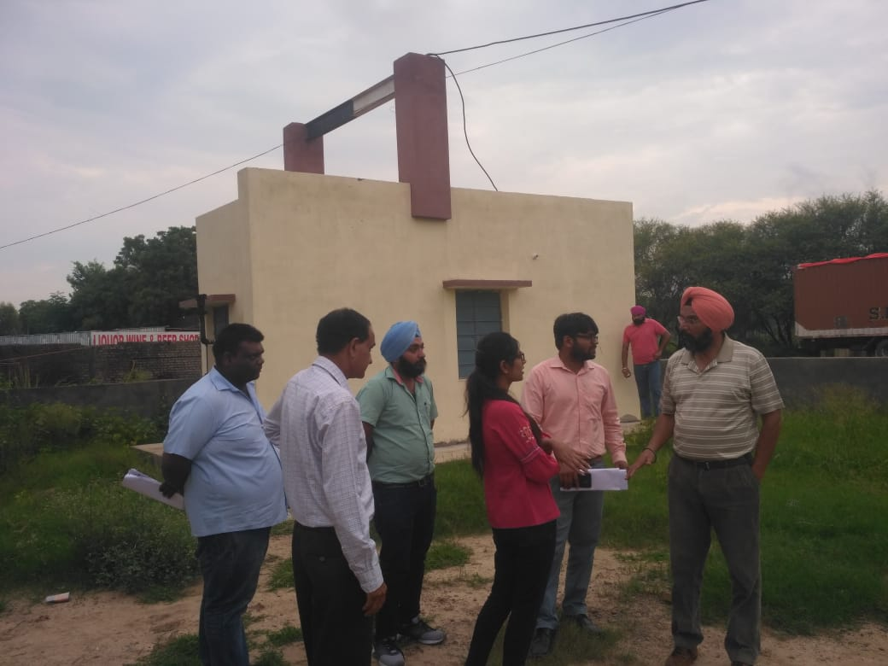
BANUR Tubewell WORK
Date of Start: 06.05.2016
Date of completion: 05.10.2016/28.03.2017
Agency: M/s Dhruv Tubewell Engineers
Allotment Cost: Rs 109.36 Lacs
Work Done: Rs 101.70 Lacs
Scope: 4 No Tubewells along with R/main
Observations
1. All tubewells Commissioned and working
2. Water samples for Heavy Metals must be got checked for water quality assurance
3. Orientation of pump chamber could have been better
4. Pillars supporting girder should be constructed from ground itself in future.
5. Instructions given for proper checking of lowering assembly while execution, using S&S Sockets instead of MS sockets
6. Chlorinators are in working condition
7. The staff was well apprised about necessary documents while procuring such as certificate from the manufacturer about strength of Hypochloride and its shelf period and its purchase bill

Slide 5
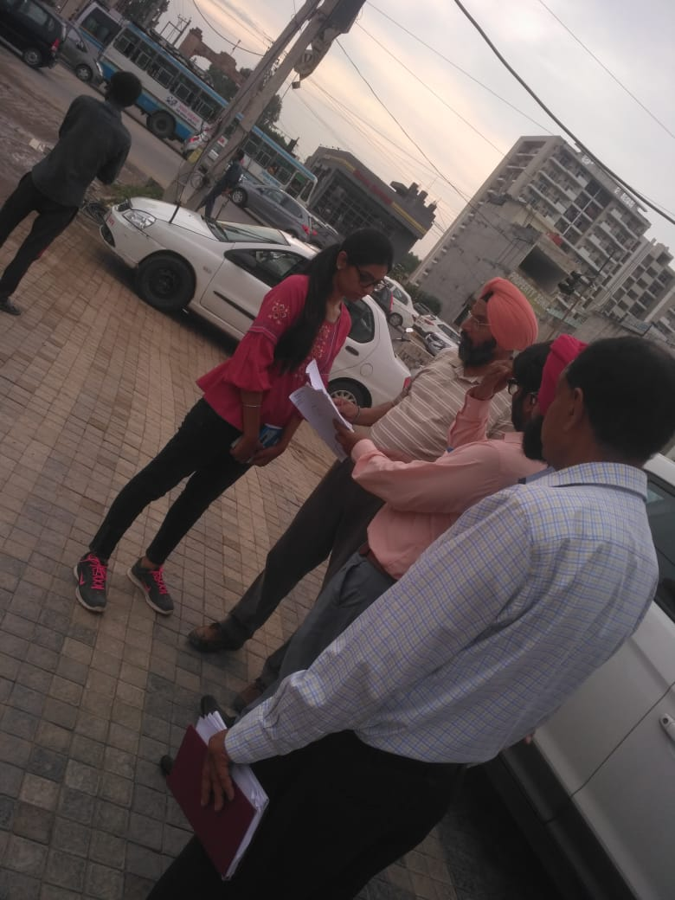
Zirakpur water supply &sewerage WORK
Date of Start: 22.03.2016
Date of completion: 21.09.2016/31.03.2017
Agency: M/s Oberai Const Co.
Allotment Cost: Rs 436.80 Lacs
Work Done: Rs 267.11 Lacs
Scope: w/s= 13.70km
  Sew= 7.80km
Observations
1. All w/s & sew Commissioned and working
2. Approx 800m sew not laid due to NH permission
3. Restoration of roads needs improvement.
4. Water supply & Sew connections done are less as compared to scope as per actual habitation.
5. O&M is with MC hence revenue from new connections, needs to be explored.

Slide 6
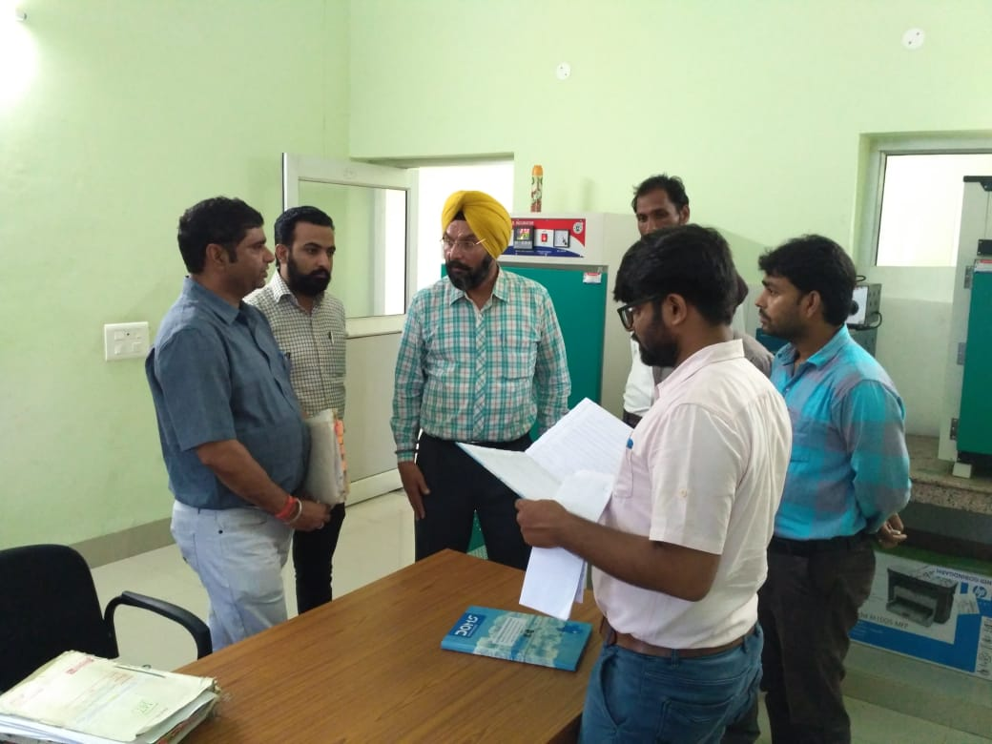
Mandi gobindgarh 25mld stp
Date of Start: 22.12.2014
Date of completion: 21.09.2015/30.06.2017
Agency: M/s Girdhari Lal Aggarwal
Allotment Cost: Rs 1725.00 Lacs
Work Done: Rs 1518.00 Lacs
Scope: 1 no 25MLD STP (SBR) +5 YR O&M
Observations
1. Laboratory is being maintained with proper record.
2. Laminar flow apparatus is not available for fecal coliform testing.
3. Standard operating procedure of sample testing in laboratory must be prepared and displayed.
4. Preventive mtc schedule of machinery and equipments must also be prepared and displayed.
4. Safety kit must be available in chlorination room.
5. Rain water harvesting system needs improvement for proper functioning.

Slide 7
Mandi gobindgarh Sewerage, mps
Date of Start: 06.2.2014
Date of completion: 05.02.2015/31.07.2018
Agency: M/s Ashok Kumar Narang cont
Allotment Cost: Rs 790.00 Lacs
Work Done: Rs 775.00 Lacs
Scope: Sewer =3.64km
    R/main=5.70km
    MPS = 1 No.
Observations
1. Old MPS also working along with new MPS. Design could have been rechecked, if double pumping can be avoided.?
2. Final bill yet to be cleared.
3. Reply to Wapcos observations is still pending with division.
4. Preventive mtc schedule of machinery must also be prepared and displayed for efficient functioning .

Slide 8
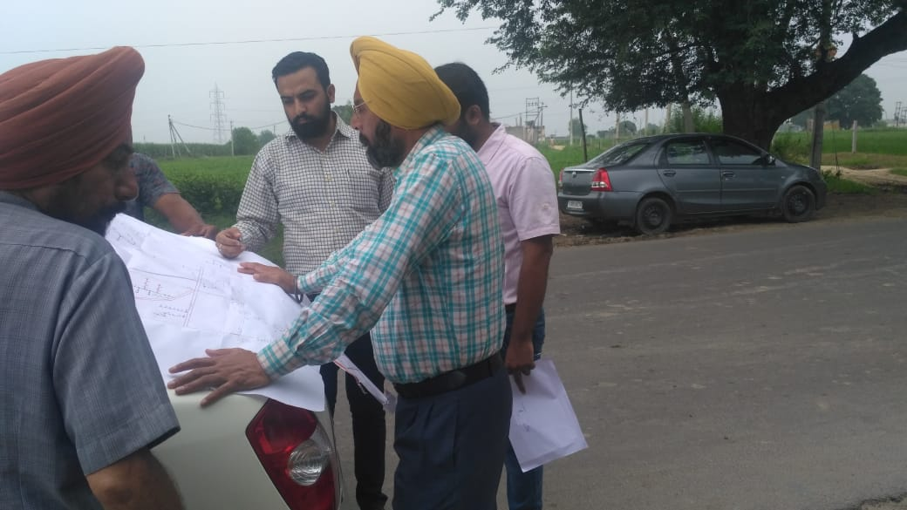
Chamkaur sahib w/s & sew work
Date of Start: 06.11.2015
Date of completion: 05.08.2016/31.01.2018
Agency: M/s Jai Maa Engineers
Allotment Cost: Rs 211.81 Lacs
Work Done: Rs 205.48Lacs
Scope: Sewer =3.23m
    w/s =3.65km
Observations
1. Final bill yet to be prepared.
2.Wapcos observations reply yet to be submitted.
3. All w/s & sew Commissioned and working
4. Restoration of roads is OK
5. Water supply & Sew connections done are less as compared to scope as per actual habitation.
6. Public awareness program must be conducted to sensitize public not to use sewerage for disposal of cow dung, plastic carry bags, bottles and dry animal fodder.
7. More efforts in conjunction with MC authorities are required for achieving w/s & sew connections as well.
8. Approval of const of IPS out of scope needs to be obtained.

Slide 9
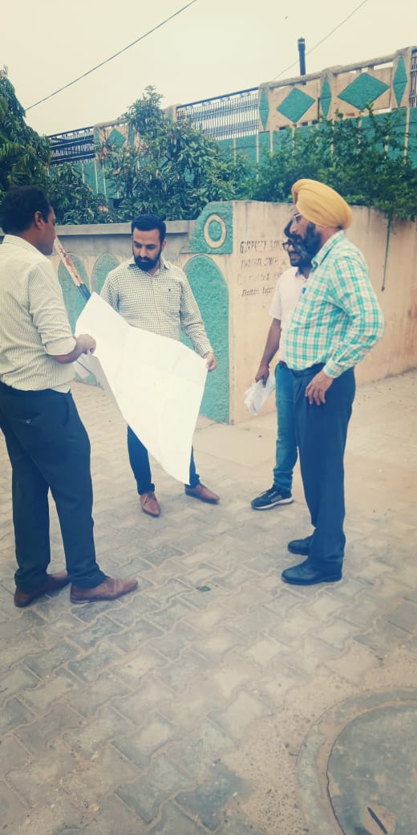
ROPAR WATER SUPPLY & SEWERAGE WORK
Date of Start: 04.01.2016
Date of completion: 03.01.2017/15.05.2017
Agency: Sh Parveet Singh Cont
Allotment Cost: Rs 787.88 Lacs
Work Done: Rs 775.02 Lacs
Scope: Sewer =9.28km
    w/s line=12.26km
Observations
1.w/s & sew lines laid more than scope.
2.All w/s & sew Commissioned and working
3. Restoration of roads is OK
4. Water supply & Sew connections done are less as compared to scope as per actual habitation and needs more efforts in conjunction with MC authorities in achieving water supply & sew connections as well.
5.Wapcos observations reply yet to be submitted.

Slide 10
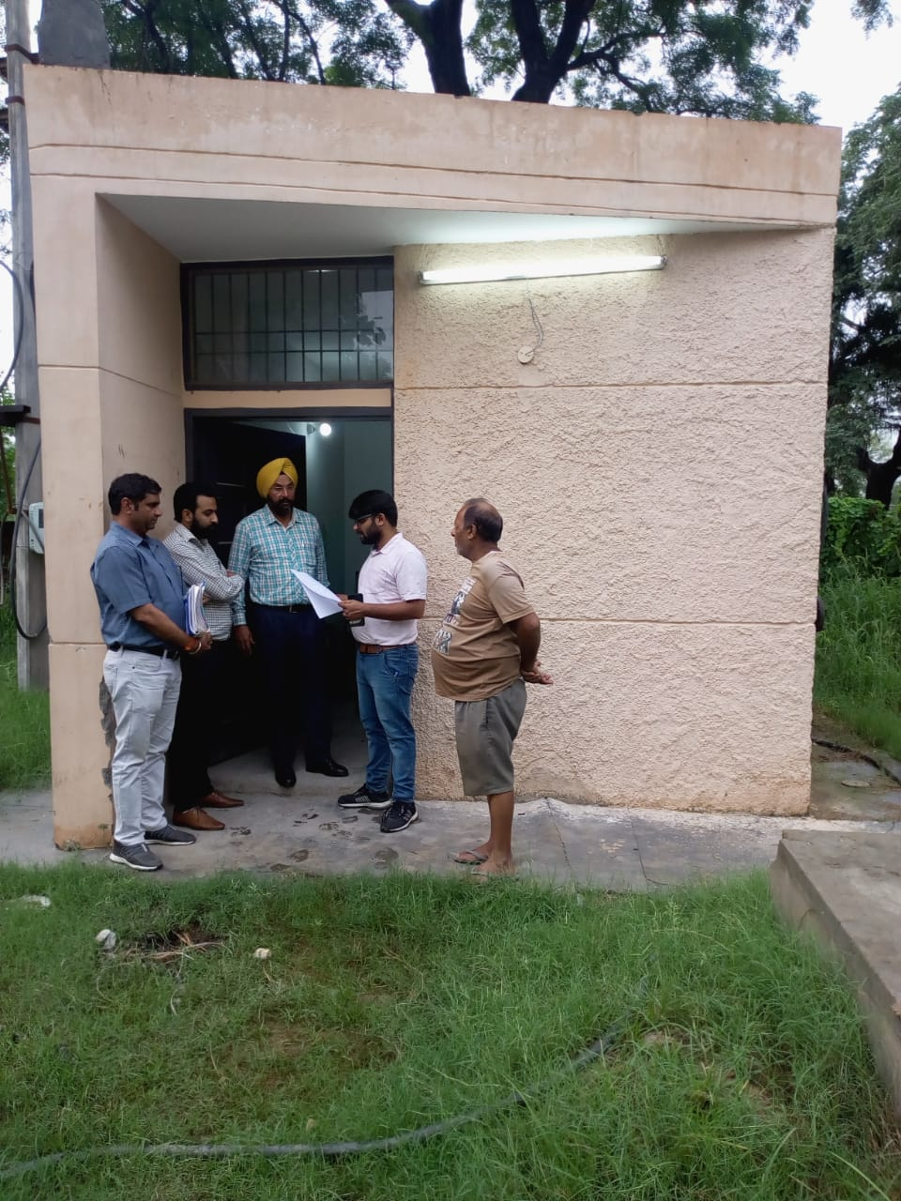
Kharar tubewell WORK
Date of Start: 08.12.2016
Date of completion: 07.04.2017/10.07.2018
Agency: M/s Guru Nan ak Tubewell
Allotment Cost: Rs 121.81 Lacs
Work Done: Rs 109.05 Lacs
Scope: 4 No tubewell
Observations
1. All tubewells Commissioned and working
2. Chlorinators are not in working condition
3. Instructions given for proper checking of lowering assembly while execution, using S&S Sockets instead of MS sockets
4. Water samples for Heavy Metals must be got checked for water quality assurance.
5. O&M is with MC authorities.
6. PWSSB staff was well apprised about necessary documents while procuring such as certificate from the manufacturer about strength of Hypochloride and its shelf period and its purchase bill

Slide 11
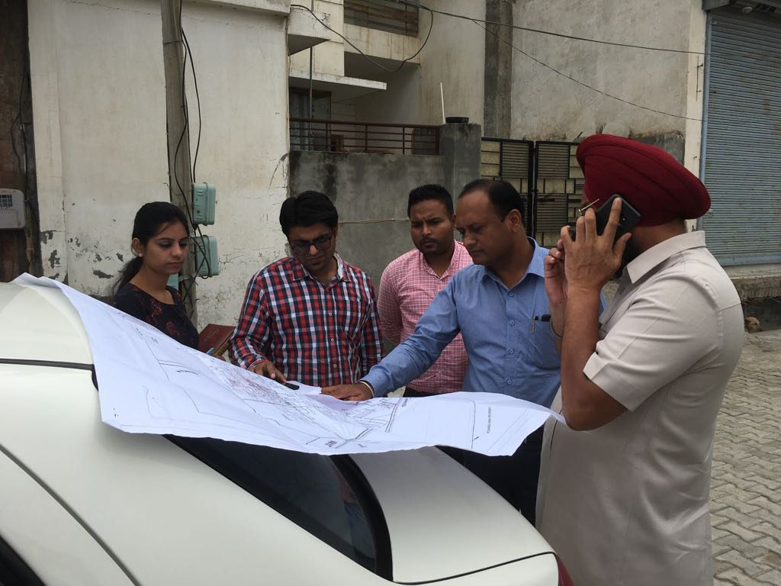
NABHA sewerage WORK
Date of Start: 03.10.2016
Date of completion: 02.02.2017/10.06.2018
Agency: Sh Kuldeep Singh Cont
Allotment Cost: Rs 367.33 Lacs
Work Done: Rs 366.88 Lacs
Scope: Sew= 11.26km
Interlocking work=1868sqm
Observations
1. All Sewer lines are Commissioned and working
2. Half of sew scope not laid on MC request.
3. The increase in Scope of Interlocking work at the cost of sewerage needs approval from competent authority
4. Restoration of roads is OK.
5. No of Sew connections are less as compared to scope as per actual habitation.
6. Public awareness program must be conducted to sensitize public not to use sewerage for disposal of cow dung, plastic carry bags, bottles and dry animal fodder.
7. More efforts in conjunction with MC authorities are required for achieving w/s & sew connections as well.
8. Construction of new MPS & STP is to be processed at the earliest.

Slide 12
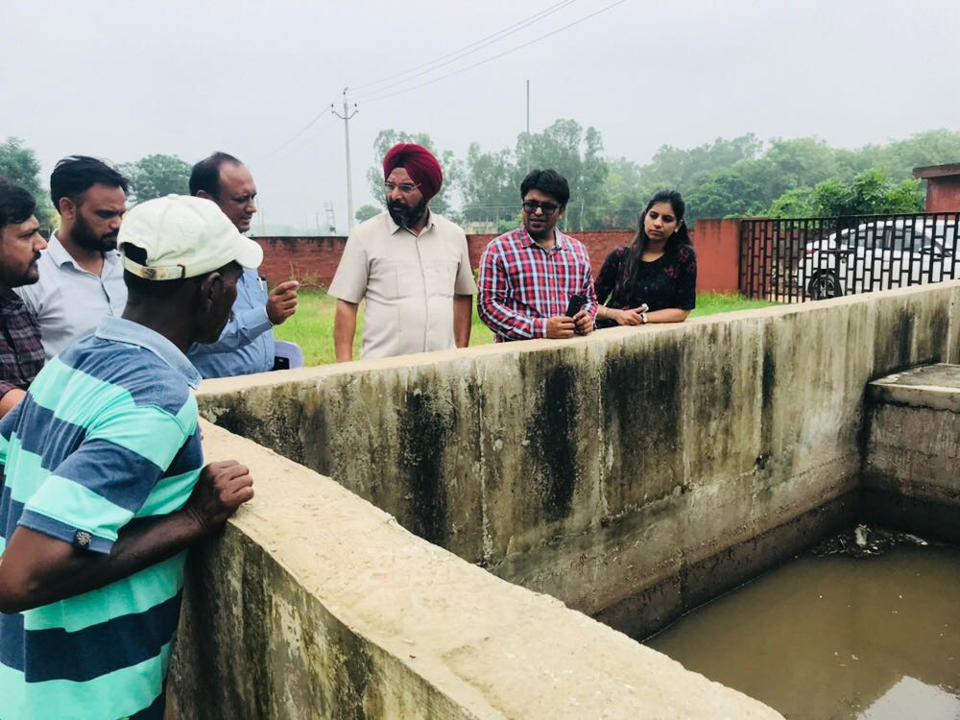
Ghanaur sewerage WORK
Date of Start: 23.05.2016
Date of completion: 22.12.2016/21.01.2017
Agency: Sh Jai Bhushan Malik
Allotment Cost: Rs 500.90Lacs
Work Done: Rs 500.76 Lacs
Scope: Sew= 15.28km
Observations
1. All sew lines are Commissioned and working
2. No of Sew connections are less as compared to scope as per actual habitation.
3. More efforts are required in conjunction with MC authorities in achieving sew connections as well.
4. Restoration of roads is OK.
5. Public awareness program must be conducted to sensitize public not to use sewerage for disposal of cow dung, plastic carry bags, bottles and dry animal fodder.
6. O&M of MPS and maintenance of record needs improvement.

Slide 13
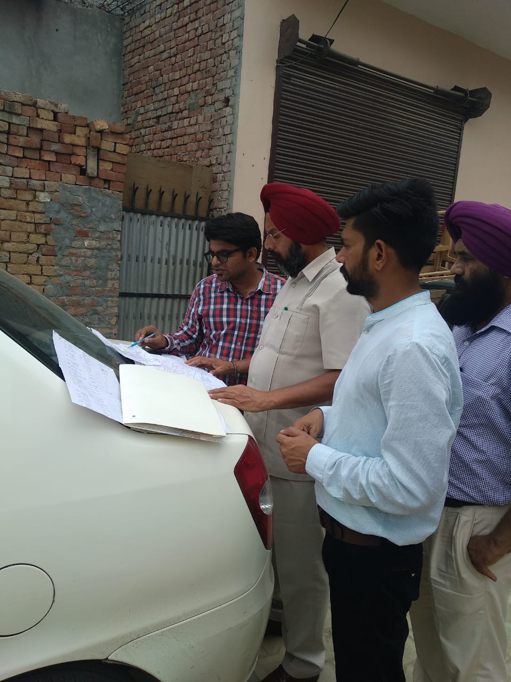
Samana w/s & sewerage WORK
Date of Start: 05.02.2016
Date of completion: 04.11.2016
Agency: Sh Madan Lal Bansal
Allotment Cost: Rs 355.00Lacs
Work Done: Rs 353.00Lacs
Scope: Sew= 4.97km
Water supply=5.05km
Observations
1. All sew & w/s Commissioned and working
2. Restoration of roads is OK.
3. No of w/s & Sew connections are less as compared to scope as per actual habitation.
4. More efforts are required in conjunction with MC authorities in achieving sew connections as well.
5. O&M is with PWSSB and water testing to be done regularly.
6. Public awareness program must be conducted to sensitize public not to use sewerage for disposal of cow dung, plastic carry bags, bottles and dry animal fodder.

Slide 14
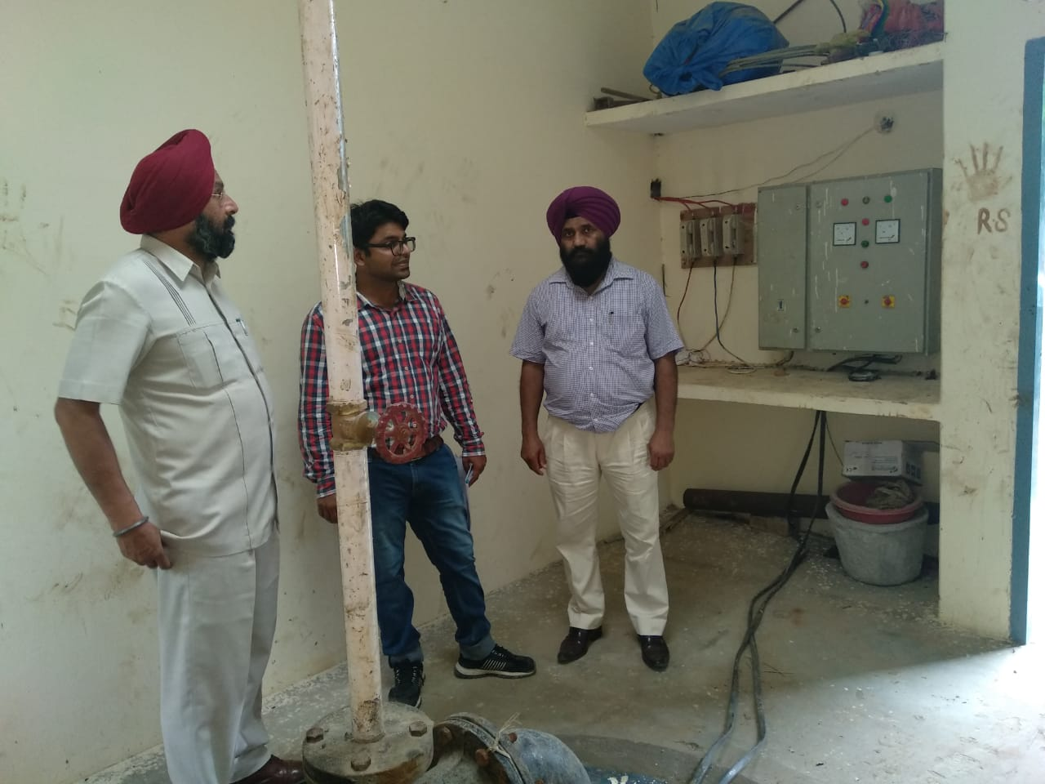
Ghagga water supply WORK
Date of Start: 02.05.2016
Date of completion: 01.08.2016
Agency: M/s Sai Baba Co-op Society
Allotment Cost: Rs 18.00Lacs
Work Done: Rs 16.19Lacs
Scope: w/s= 1.64km
Observations
1. All w/s Commissioned and working
2. Restoration of roads is OK.
3. More efforts are required in conjunction with MC authorities in achieving w/s connections as well.
4. No sewerage is existing in town.

Slide 15
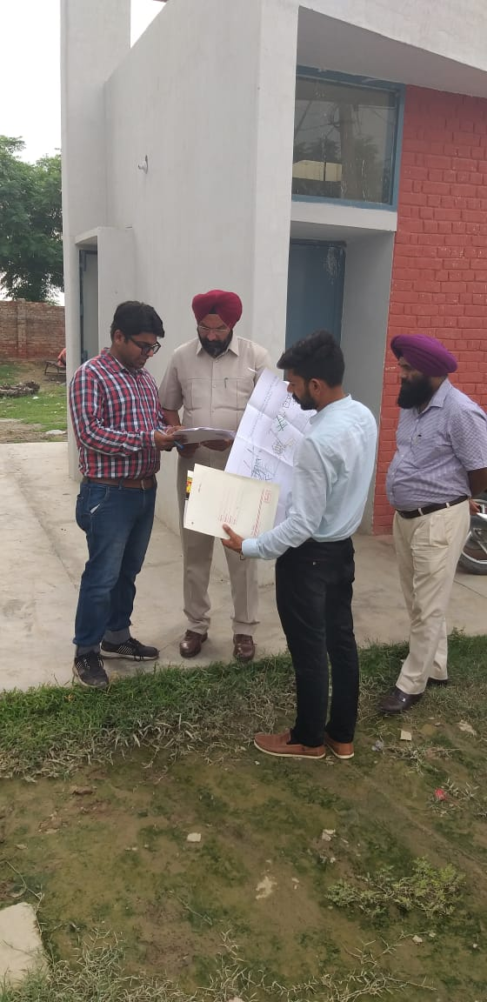
Patran water supply, ohsr & sew WORK
Date of Start: 05.02.2016
Date of completion: 04.11.2016/31.07.2018
Agency: M/s R G Industries
Allotment Cost: Rs 453.00Lacs
Work Done: Rs 417.00Lacs
Scope: w/s= 7.86km
  Sew =8.31km
  OHSR =1 No
Observations
1. All w/s & sew Commissioned and working
2. More efforts are required in conjunction with MC authorities in achieving w/s & sew connections as well.
3.Public awareness program must be conducted to sensitize public not to use sewerage for disposal of cow dung, plastic carry bags, bottles and dry animal fodder.
4. OHSR is working properly.
5. O&M is with MC authorities.
6. Restoration of roads is OK.

Slide 16
CHECKING OF BATHINDA CIRCLE WORKS
SITE: Checking of 4.5 MLD STP at Dairy Complex visited on 02.08.2018
Observations
1. The shuttering work fo MPS of 4.5 mld cap ASP STP is in progress.
2. Progress of work slow.
3. Agency has been asked to employ more labour and equipment to speed up the work.
4. Similarly progress of construction of aeration tank, clarifier and ccty is also slow.
5. To start work of laying of 500 mm DI pipe, Xen has been directed to pursue case of payment of 0.96 lacs to PWD from earliest.
6. Restoration of roads is OK.
7. Material testing equipments for checking of FM of fine and course aggregate and installation of CTM for cube strength test has been installed at STP Site.

Slide 17
CHECKING OF BATHINDA CIRCLE WORKS
SITE: Checking of Boha town in Mansa Cluster visited on 09.08.2018
Observations
1. The work of laying of 200 mm SW pipe in progress and 45% laid which needs more manpower for speedy work.
2. The work of interlocking tiles is also in progress and only 17% work completed.
3. Agency ensured to engage more man power to achieve speedy progress.
4. MPS work in progress and shuttering of 2^{nd.} Lift is in progress.
5. Agency is yet to provide design of 2 mld STP.
6. The issues of shifting of poles resolved.
7. NOC from B&R dept will be resolved within this week.
8. Xen has also applied for NOC from Canal crossing and asked for persual too.
9. Laboratory should be properly established and functioning along with proper record maintenance.

Slide 18
CHECKING OF BATHINDA CIRCLE WORKS
SITE: Checking of Abohar town visited on 22.08.2018
Observations
1. The work of laying of 800 mm size of di pipe in progress at New Fazilka road.
2. Construction of manholes on kandhwala road, seed farm road, many peer tibba road 9 nos in progress today.
3. Desilting with super sucker machine is going on sito road..
4. Commissioning of sewerage system at thakur abadi area is quite slow..
5. Agency has been directed to commission in week’s time.
6. Agency has been asked to start work on downstream on remaining strecth .

Slide 19
Steps has been taken to improve Quality Insurance
Ensure availability of field laboratories at every Town for quality testing of material
To ensure checking of manufacturing test certificates and purchase bill of procured material/machinery to field officers.
Post quality testing of finished works such as hydraulic test and smoke test.
Random material testing from Third party NABL accredited laboratory.
Must ensure that proper records are maintained of "Site documents”
To ensure Mandatory and optional testing
Personnel protective equipment (PPE) for field staff.

Slide 20
Steps Taken to Improve in O&M delivery Services
ONLINE BILLING BENEFITS
WATER QUALITY MAINTAINCE
BENEFITS OF METERING WATER

Slide 21
Steps Taken to Improve in O&M delivery Services
ONLINE BILLING BENEFITS
Get Rid of Calculation Errors : With an online billing system, the invoices for customers will be automatically calculated. This reduces the possibility of human error, so your customers will never be incorrectly charged.
Save Money : less mistakes will also save money. Humans are bound to make errors when making calculations, but machines are almost infallible.
Stay More Transparent : With automated billing, it’s easy to review every step in the process and make sure all of the necessary information is saved and correct. You can easily find a client’s information in the system and get back to them more quickly.
Billing from Anywhere : customers are free to bill from any place and any time
Communicate with Clients Faster : With Online billing system clients get their receipts and other information right away. This speeds up the communication process, making it easier to resolve problems quickly.
Use Less Paper and Stamps : save money on both paper products and employee costs due switch to an online billing system.

Slide 22
Steps Taken to Improve in O&M delivery Services
WATER QUALITY MAINTAINCE
Multi-parameter Water Quality Field Test Kits : Multi-parameter Water Quality Field Test Kit have been procured in every SUB-DIVISION for physico-chemical analysis.
Regular Sampling
Regular checking of residual chlorine, contamination of water, leakages and availability of water is being checked by field staff at consumer end.
S.no | Size | Residual chlorination | Toxic Substances | bacteriological | Chemical
1 | 20000 | Daily | Quarterly | Every month | twice in year
2 | 20000 to 50000 | Daily | Quarterly | 1 in two week | Quarterly
3 | 50000 to 1 lac | Daily | Quarterly | 1 in four days | Quarterly
4 | 1 lac and more | Daily | Quarterly | 1 in every day | Quarterly

Slide 23
Steps Taken to Improve in O&M delivery Services
BENEFITS OF METERING WATER
Proper Distribution: ensure a judicious and equitable distribution and efficient use of available water resources in a most sustainable and sound economic manner for domestic and commercial purpose.
Quantative Supply : initiate corrective measures to control, regulate, manage, conserve and augment the declining over-exploited ground water resources for its development on a long term basis with the involvement of all stakeholders
Optimum Usage : promote the safe use and disposal of water and optimize the reuse of water by re-cycling the treated industrial effluent and sewage for irrigation, industry and other permissible uses.
User Participation : To ensure effective participation of users in developing, operating and maintaining water supply services and to empower them to manage their own water supply and environmental sanitation services
Harmony in Public: Ensure proper harmony in public mind as the meter billing is on the actual consumption basis.
Less Electric consumption. Metering also helps in reducing electric consumption.

Slide 24
Review of Cluster works microplanning
1. Bathinda Cluster by M/s Triveni
2. Mansa Cluster by M/s GDCL
3. Kotkapura Cluster by M/s SPCPL
4. Abohar Cluster by M/s SPCPL

Slide 25
Bathinda Cluster by M/s Triveni
Sr No | Target | Achievement (16 Aug to 22 Aug) | Backlog
1 | Lateral Sew : 700m | 416m | -284
2. | Main sewer: 50m | 73m | +23
3. | Water supply line: 0 m | 27.5m | +27.5
4. | R/Main 1200mm):125m | 0 m
5. | Water meter : 400 No | 0 | -400
6. | MPS : 4% | 1% | -3%
7. | STP : 3.3% | 1% | -2.3%
8. | WTP: 1.4% | 0.4% | -1%
9. | O&M Machinery | AVAILABLE AS PER AGREEMENT

Slide 26
MANSA Cluster by M/s GDCL
MANSA TOWN
Sr No | Target | Achievement (16 Aug to 22 Aug) | Backlog
1 | Lateral Sew : 50m | 0m | -50
2. | Interlocking : 1000sqm | 364 sqm | -636
3. | House connection: 15 No | 22 No | +7
4 | O&m machinery | Not available as per agreement
budhlada TOWN
Sr No | Target | Achievement (16 Aug to 22 Aug) | Backlog
1 | Lateral Sew : 175m | 208.8m | +33.8
2. | Interlocking : 1500sqm | 907sqm | -593
3. | Connections: 30 No | 74 | +44
4 | O&m machinery | Not available as per agreement

Slide 27
MANSA Cluster by M/s GDCL
BARETA TOWN
Sr No | Target | Achievement (16 Aug to 22 Aug) | Backlog
1 | OHSR : 10% | 10% | 0
2. | Interlocking : 400sqm | 0sqm | -400
3. | O&m machinery | Not available as per agreement
BHIKHI TOWN
Sr No | Target | Achievement (16 Aug to 22 Aug) | Backlog
1 | House connection: 10 No | 0 | -10
2. | Interlocking : 400sqm | 145sqm | -355
3. | O&m machinery | Not available as per agreement

Slide 28
MANSA Cluster by M/s GDCL sardulgarh TOWN
Sr No | Target | Achievement (16 Aug to 22 Aug) | Backlog
1 | Lateral Sew : 30m | 0m | -30
2. | Interlocking : 0 sqm | 0 sqm | 0
3. | House connection: 8No | 0 No | -8
4 | O&m machinery | Not available as per agreement
Boha TOWN
Sr No | Target | Achievement (16 Aug to 22 Aug) | Backlog
1 | Lateral Sew : 600m | 120.60m | -479.4
2. | Interlocking : 2000sqm | 1523sqm | -477
3. | Connections: 60No | 57 | -3
4 | MPS : 5% | 4% | -1

Slide 29
Kotkapura Cluster by M/s spcpl faridkot TOWN
Sr No | Target | Achievement (16 Aug to 22 Aug) | Backlog
1 | Lateral Sew : 500m | 670m | +170
2. | Interlocking : 3000sqm | 2441 sqm | -559sqm
3. | Manhole: 14No | 16 No | +2
4 | O&m machinery | available as per agreement
kotkapura TOWN
Sr No | Target | Achievement (16 Aug to 22 Aug) | Backlog
1 | Lateral Sew : 800m | 680m | -120m
2. | Interlocking : 3000sqm | 3386sqm | +386
3. | Connections: 250No | 87 | -163
4 | MPS : 2% | 2% | 0
5 | STP: 1% | 1% | 0

Slide 30
Kotkapura Cluster by M/s spcpL
JAITU TOWN
Sr No | Target | Achievement (16 Aug to 22 Aug) | Backlog
1 | Lateral Sew : 200m | 299m | +99m
2. | Interlocking : 3000sqm | 3236 sqm | +236sqm
3. | Manhole: 6No | 14No
4 | Main sewer: 50m | 97.5m | +47.5m
5 | o%&m machinery | As per agreement available

Slide 31
Abohar Cluster by M/s spcpl abohar TOWN
Sr No | Target | Achievement (16 Aug to 22 Aug) | Backlog
1 | Lateral Sew : | 24 m | 0
2. | Main Sew : 62 m | 9.35 m | - 52.65 m
3. | Manhole: 42No | 69 No | +27
4 | WTP Components : 2% | 2 % | 0
5 | O&M Machinery | Available as required | 0

Slide 32
Abohar Cluster by M/s spcpl guruharsahai town TOWN
Sr No | Target | Achievement (16 Aug to 22 Aug) | Backlog
1 | Lateral Sew : 215 m | 122 m | -93 m
2. | Main Sew : 215 m | 34 m | - 181 m
3. | Manhole: 16 No | 8 No | - 8 no
Arniwala TOWN
Sr No | Target | Achievement (16 Aug to 22 Aug) | Backlog
1 | Main Sew : 257 m | 100 m | - 157 m
2. | Manhole : 6 No | 6 No | 0

Slide 33
Challenges realates to o&m
Shortage of supervisory staff.
Shortage of funds for O&M. In most of the towns, the tariffs are so low that they do not even cover the annual operation & maintenance cost.
Non availability of required machinery for proper sewerage maintenance
Non Co-operation from public in revenue recovery.
Lack of public awareness for owning the assets.
Due to insufficient funds on O&M schemes, pendency of electricity bills are increasing Which leads to disconnection of power supply sometimes.
Notes:
imes

Slide 34
Challenges realates to o&m
Expenditures of establishment/Repair & electricity bills on O&M scheme are more than revenue and VAT share. Percentage of VAT Share given to PWSSB needs to be seriously reviewed.
Due to presence of dairies , inflow of cow dung ,animal fodder etc domestic sewer system gets chocked most of times which create hue and cry in public
Due to absence of storm sewer system, domestic sewerage system gets flooded during raining season.
Use of plastic bags, connecting road gullies with sanitary sewer for disposal of rain water are major misuses of sewerage system.
Machinery on O&M Installations are quite old and needs immediate replacement for efficient working.

Slide 35
THANKS

